Slide 1
Gaming Chat Toxicity Classification
Project Description
This project presents an intelligent gaming chat moderation system that automatically detects toxic messages using an Ensemble Machine Learning approach. The system analyzes player chat messages, identifies multiple toxicity categories—including Toxic, Severe Toxic, Obscene, Threat, Insult, and Identity Hate—and recommends appropriate moderation actions based on the severity of the detected content. By combining TF-IDF feature extraction with an Ensemble model consisting of Logistic Regression and Random Forest classifiers wrapped in a Multioutput Classifier, the system provides accurate multi-label classification for gaming chat moderation.

Slide 2
Key Features
Technologies Used
Multi-label toxicity classification
TF-IDF text feature extraction
Ensemble Machine Learning model
Severity score calculation (1–5)
Automated moderation recommendations
Detection log generation
Interactive Gradio-based user interface
Python
Pandas
NumPy
Scikit-learn
TF-IDF Vectorizer
Logistic Regression
Random Forest
Voting Classifier
Multioutput Classifier
Gradio

Slide 3
Toxicity Categories
Toxic
Severe Toxic
Obscene
Threat
Insult
Identity Hate
Moderation Actions
Severity | Action
1 | Allow
2 | Warning
3 | Mute
4 | Temporary Ban
5 | Auto Ban

Slide 4
Introduction
Online multiplayer games have become one of the most popular forms of entertainment, allowing millions of players to communicate and collaborate through real-time chat systems. While these chat features improve teamwork and player interaction, they also create opportunities for toxic behavior such as abusive language, insults, threats, hate speech, and harassment.
Toxic communication negatively affects the gaming experience by reducing player engagement, encouraging cyberbullying, and creating an unsafe environment for users. Manual moderation of millions of chat messages is time-consuming, inconsistent, and difficult to scale.
To address this challenge, this project proposes an Ensemble Machine Learning-based Gaming Chat Toxicity Classification System that automatically detects toxic messages in real time. The system uses TF-IDF feature extraction along with an Ensemble Model combining Logistic Regression and Random Forest classifiers wrapped inside a MultiOutputClassifier to perform multi-label toxicity classification.
The model identifies six toxicity categories:
Toxic
Severe Toxic
Obscene
Threat
Insult
Identity Hate
Based on the detected categories, the system calculates a severity score and recommends an appropriate moderation action such as Allow, Warning, Mute, Temporary Ban, or Auto Ban. This intelligent moderation system helps gaming platforms maintain a safer, more respectful, and enjoyable environment for all players.

Slide 5
Problem Statement
Online multiplayer games enable players to communicate through real-time chat, enhancing teamwork and collaboration. However, these chat systems are often misused to spread abusive language, insults, threats, hate speech, and other forms of toxic behavior. Such toxic communication creates a negative gaming environment, discourages player participation, and can lead to cyberbullying and harassment.
Traditional moderation methods rely heavily on human moderators, making them time-consuming, expensive, and unable to keep pace with the massive volume of chat messages generated every day. Furthermore, a single message may contain multiple forms of toxicity simultaneously, making accurate moderation even more challenging.
Therefore, there is a need for an automated, intelligent, and scalable system capable of identifying multiple toxicity categories in real time and recommending appropriate moderation actions. This project addresses this challenge by developing an Ensemble Machine Learning-based Gaming Chat Toxicity Classification System that performs multi-label classification, calculates toxicity severity, and supports automated moderation.
Key Challenges
Millions of gaming chat messages are generated every day.
Toxic behavior includes insults, threats, hate speech, and abusive language.
Manual moderation is slow, costly, and difficult to scale.
A single chat message can belong to multiple toxicity categories.
Delayed moderation negatively impacts player experience and community safety.
Existing moderation systems may fail to detect disguised or obfuscated toxic words.

Slide 6
Objectives
The primary objective of this project is to develop an intelligent and automated gaming chat moderation system that accurately identifies toxic messages and recommends appropriate moderation actions to ensure a safe and positive gaming environment.
Specific Objectives
Develop an Ensemble Machine Learning model for gaming chat toxicity detection.
Perform multi-label classification, allowing a single message to belong to multiple toxicity categories.
Detect the following six toxicity labels:
  Toxic
  Severe Toxic
  Obscene
  Threat
  Insult
  Identity Hate
Preprocess gaming chat messages by removing noise, special characters, repeated letters, and obfuscated words.
Convert textual chat messages into numerical features using the TF-IDF Vectorizer.
Improve prediction accuracy by combining Logistic Regression and Random Forest using a Voting Classifier.
Calculate a severity score (1–5) based on the detected toxicity labels.
Recommend automated moderation actions such as:
  Allow
  Warning
  Mute
  Temporary Ban
  Auto Ban
Generate detection logs for monitoring and analysis.
Develop an interactive Gradio application for real-time toxicity prediction and moderation.

Slide 7
Dataset
This project uses the Jigsaw Toxic Comment Classification Dataset, a widely used benchmark dataset for detecting toxic and abusive online text. The dataset contains user-generated comments that are manually annotated with multiple toxicity labels, making it suitable for developing multi-label text classification models.
The dataset was preprocessed and balanced before training the model to improve classification performance and reduce the impact of class imbalance.
Dataset Information
Dataset Name: Jigsaw Toxic Comment Classification Dataset
Data Type: Text (User Comments)
Classification Type: Multi-Label Classification
Language: English

Slide 8
Toxicity Categories
The model predicts the following six toxicity labels:
Toxic | General abusive or offensive language
Severe Toxic | Extremely aggressive or highly offensive comments
Obscene | Comments containing vulgar or profane language
Threat | Messages expressing violence or threats
Insult | Personal attacks or insulting language
Identity Hate | Hate speech targeting race, religion, gender, nationality, or other identities

Slide 9
Dataset Workflow
Jigsaw Toxic Comment Dataset
│
▼
Raw Text Comments
│
▼
Text Preprocessing
│
▼
Dataset Balancing
│
▼
Train-Test Split (80:20)
│
▼
Model Training

Slide 10
System Architecture
The proposed Gaming Chat Toxicity Classification System follows a structured pipeline that transforms raw gaming chat messages into moderation decisions. The system begins with collecting chat messages, performs text preprocessing to clean and normalize the data, extracts meaningful textual features using the TF-IDF Vectorizer, and then classifies the messages using an Ensemble Machine Learning model. Finally, the system assigns a severity score and recommends an appropriate moderation action.

Slide 11
Architecture Components
1. Gaming Chat Input
Receives chat messages from players in real time.
2. Text Preprocessing
Converts text to lowercase.
Removes obfuscated words.
Eliminates repeated characters.
Removes special characters.
Produces clean and normalized text.
3. TF-IDF Feature Extraction
Converts cleaned text into numerical feature vectors.
Preserves important words and phrases using unigram and bigram features.

Slide 12
4. Ensemble Machine Learning Model
Logistic Regression captures linear text patterns.
Random Forest learns complex decision boundaries.
Voting Classifier combines predictions using soft voting for improved accuracy.
5. Multioutput Classifier
Enables simultaneous prediction of multiple toxicity labels for a single message.
6. Severity Score Calculation
Computes a severity score from 1 to 5 based on the predicted toxicity labels.
7. Moderation Recommendation
Based on the severity score, the system recommends:
Allow
Warning
Mute
Temporary Ban
Auto Ban

Slide 13
8. Detection Log Generation
Records the original message, predicted labels, severity score, confidence, and recommended action for auditing and analysis.
9. Gradio User Interface
Displays the prediction results, severity score, and moderation action in an interactive web interface.
Key Advantages of the Architecture
Modular and scalable design.
Supports multi-label toxicity detection.
Uses an Ensemble Machine Learning approach for improved prediction accuracy.
Provides real-time moderation recommendations.
Easily deployable as a web application using Gradio.

Slide 14
Text Preprocessing
Text preprocessing is one of the most important stages in the Gaming Chat Toxicity Classification System. Gaming chat messages often contain spelling variations, repeated characters, special symbols, abbreviations, and intentionally obfuscated words that can reduce the accuracy of machine learning models. Therefore, preprocessing is performed to clean and normalize the text before feature extraction.
The project uses a custom Text Processor class to transform raw chat messages into a standardized format suitable for TF-IDF feature extraction and classification.

Slide 15
Preprocessing Workflow
Raw Gaming Chat
│
▼
Convert to Lowercase
│
▼
Remove Obfuscated Words
│
▼
Remove Repeated Characters
│
▼
Remove Spaced Letters
│
▼
Remove Special Characters
│
▼
Normalize White Spaces
│
▼
Clean Text

Slide 16
TF-IDF (Term Frequency–Inverse Document Frequency)
TF-IDF Feature Extraction
After preprocessing, the cleaned gaming chat messages cannot be directly used by machine learning algorithms because they work with numerical data rather than text. Therefore, the cleaned text is converted into numerical feature vectors using the TF-IDF (Term Frequency–Inverse Document Frequency) Vectorizer.
TF-IDF measures the importance of a word in a document relative to the entire dataset. Words that appear frequently in a particular comment but less frequently across all comments receive higher weights, making them more useful for toxicity classification.
Raw Chat Message
│
▼
Preprocessed Text
│
▼
Tokenization
│
▼
Vocabulary Creation
│
▼
TF Calculation
│
▼
IDF Calculation
│
▼
TF-IDF Feature Vector
│
▼
Machine Learning Model

Slide 17
Ensemble Model
Ensemble Machine Learning Model
The core of this project is an Ensemble Machine Learning Model designed to improve the accuracy and robustness of gaming chat toxicity classification. Instead of relying on a single algorithm, the model combines the strengths of Logistic Regression and Random Forest using a Voting Classifier. Since a single gaming chat message can belong to multiple toxicity categories simultaneously, the ensemble model is wrapped inside a Multioutput Classifier to perform multi-label classification.
This combination enables the system to produce more reliable predictions and better generalize to unseen gaming chat messages.
TF-IDF Feature Vector
│
▼
┌─────────────────────────────────┐
│ Voting Classifier │
└─────────────────────────────────┘
│ │
▼ ▼
Logistic Regression Random Forest
Classifier Classifier
│ │
└────────┬────────┘
▼
Soft Voting Result
│
▼
Multioutput Classifier
│
▼
Toxic │ Severe Toxic │ Obscene
Threat │ Insult │ Identity Hate

Slide 18
Model Components
1. Logistic Regression
A linear classification algorithm.
Works well with high-dimensional TF-IDF features.
Provides probability estimates for each toxicity label.
Fast to train and efficient for text classification.
Advantages
Simple and interpretable.
Handles sparse TF-IDF vectors efficiently.
Produces reliable probability scores.
2. Random Forest
An ensemble of multiple decision trees.
Learns complex and non-linear relationships in text features.
Reduces overfitting through bagging.
Improves robustness and prediction accuracy.
Advantages
Handles complex patterns.
Resistant to noise and overfitting.
Captures feature interactions effectively.

Slide 19
3. Voting Classifier (Soft Voting)
The Voting Classifier combines the probability predictions from both base models.
Instead of selecting the prediction from only one model, it averages the predicted probabilities and chooses the final output.
Logistic Regression Probability
+
Random Forest Probability
│
▼
Average Probability
│
▼
Final Prediction

Slide 20
Why an Ensemble Model?
Combines the strengths of multiple machine learning algorithms.
Improves prediction accuracy compared to a single classifier.
Produces more reliable and stable predictions.
Handles diverse toxicity patterns effectively.
Reduces the limitations of individual models.
Advantages in This Project
Accurate multi-label toxicity classification.
Efficient handling of TF-IDF feature vectors.
Robust prediction using complementary models.
Scalable and suitable for real-time gaming chat moderation.
Generates probability scores used for severity calculation and moderation decisions.

Slide 21
Model Training
Model Training
After preprocessing the gaming chat messages and converting them into numerical features using the TF-IDF Vectorizer, the Ensemble Machine Learning model was trained to perform multi-label toxicity classification. The training process involved preparing the dataset, fitting the ensemble model, and measuring the training time to evaluate computational efficiency.
The model combines Logistic Regression and Random Forest classifiers using a Soft Voting Classifier, which is then wrapped inside a Multioutput Classifier to predict multiple toxicity labels simultaneously.

Slide 22
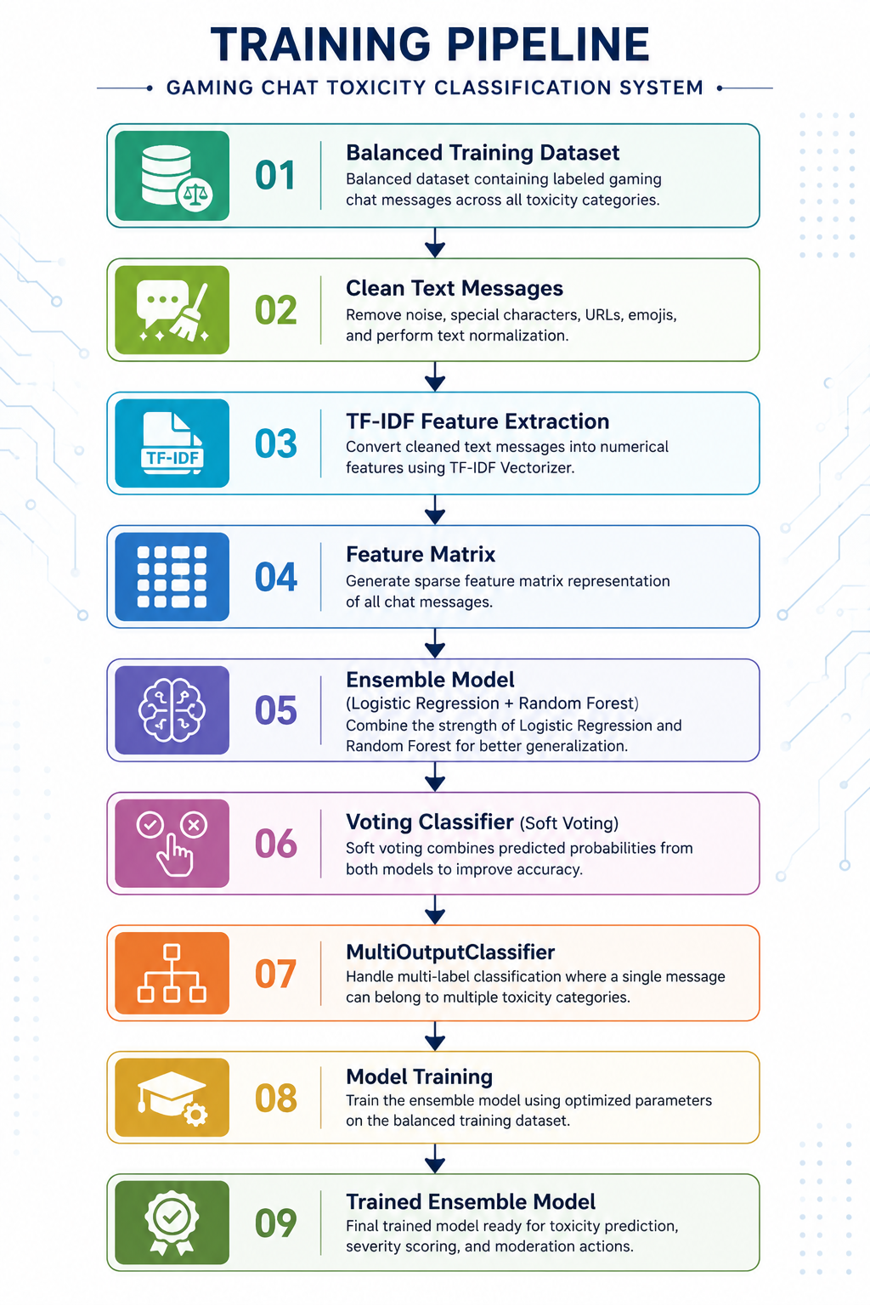

Slide 23
Training Process
Step 1: Prepare Training Data
Use the balanced dataset to reduce class imbalance.
Split the dataset into 80% training and 20% testing.
Extract TF-IDF features from the training text.
Step 2: Initialize Base Models
Two machine learning algorithms are selected:
Logistic Regression
  Fast and efficient for text classification.
  Performs well with sparse TF-IDF vectors.
Random Forest
  Captures complex patterns and non-linear relationships.
  Reduces overfitting through multiple decision trees.
Step 3: Create Voting Classifier
Combine Logistic Regression and Random Forest.
Use Soft Voting to average prediction probabilities.
Produce a more accurate final prediction.

Slide 24
Step 4: Multi-Label Training
Wrap the Voting Classifier inside a Multioutput Classifier.
Train one classifier for each toxicity category.
Enable simultaneous prediction of:
  Toxic
  Severe Toxic
  Obscene
  Threat
  Insult
  Identity Hate
Step 5: Train the Model
Train the ensemble model using the TF-IDF feature matrix.
Measure the total training time.
Store the trained model for future predictions.

Slide 25
Training Configuration
Parameter | Value
Feature Extraction | TF-IDF Vectorizer
Base Model 1 | Logistic Regression
Base Model 2 | Random Forest
Ensemble Method | Soft Voting
Multi-label Technique | MultiOutputClassifier
Train-Test Split | 80 : 20
Random State | 42 / 67
Class Balancing | Balanced Dataset
Output Labels | 6 Toxicity Categories

Slide 26
Training Output
During training, the following information is generated:
Trained Ensemble Model
Training Time
Multi-label Classification Model
Probability-based Prediction Model
Ready-to-use Model for Testing and Deployment
Benefits of the Training Process
Learns toxicity patterns from gaming chat messages.
Improves prediction accuracy by combining multiple classifiers.
Supports simultaneous prediction of multiple toxicity labels.
Produces probability scores for severity calculation.
Creates a reusable model for real-time moderation.

Slide 27
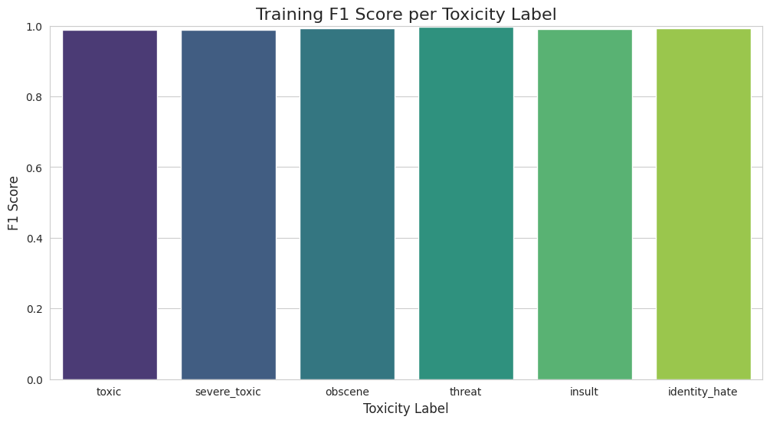
This graph presents the Training F1 Score for each toxicity category. The Ensemble Model achieved F1 Scores close to 1.0 across all six labels, indicating excellent learning of the training data. High F1 Scores demonstrate a strong balance between Precision and Recall. However, these results should be compared with testing performance to ensure that the model generalizes well and is not overfitting.
Label | Observation
Toxic | Very high F1 Score (≈0.99)
Severe Toxic | Very high F1 Score (≈0.99)
Obscene | Very high F1 Score (≈0.99)
Threat | Nearly perfect F1 Score (≈1.00)
Insult | Very high F1 Score (≈0.99)
Identity Hate | Very high F1 Score (≈0.99)

Slide 28
Model Evaluation
After training the Ensemble Machine Learning model, its performance was evaluated on the test dataset to measure its ability to correctly classify gaming chat messages into multiple toxicity categories. The evaluation assesses the model using standard machine learning metrics, including Accuracy, Precision, Recall, F1-Score, Confidence Level, and Inference Time.
The evaluation demonstrates how effectively the model generalizes to unseen data and identifies toxic messages across all six toxicity categories.

Slide 29
Evaluation Workflow
Trained Ensemble Model
│
▼
Test Dataset
│
▼
TF-IDF Feature Extraction
│
▼
Model Prediction
│
▼
Performance Metrics
│
▼
Accuracy • Precision • Recall
F1-Score • Confidence
Inference Time

Slide 30
Performance Metrics Generated
The evaluation provides metrics for each toxicity category:
Toxic
Severe Toxic
Obscene
Threat
Insult
Identity Hate
For each label, the following metrics are calculated:
Accuracy
Precision
Recall
F1-Score
Confidence Level
Additionally, overall performance is reported using:
Macro Accuracy
Macro Precision
Macro Recall
Macro F1-Score
Overall Confidence
Total Inference Time
Average Time per Sample

Slide 31
Advantages of the Evaluation
Evaluation Pipeline
Test Dataset
│
▼
TF-IDF Transformation
│
▼
Ensemble Model Prediction
│
▼
Probability Scores
│
▼
Metric Calculation
│
▼
Accuracy • Precision • Recall
F1-Score • Confidence
│
▼
Evaluation Report
Measures the effectiveness of the ensemble model.
Evaluates performance for each toxicity category individually.
Confirms the model's ability to generalize to unseen gaming chat messages.
Ensures the model is suitable for real-time moderation systems.
Provides quantitative evidence of model performance.

Slide 32
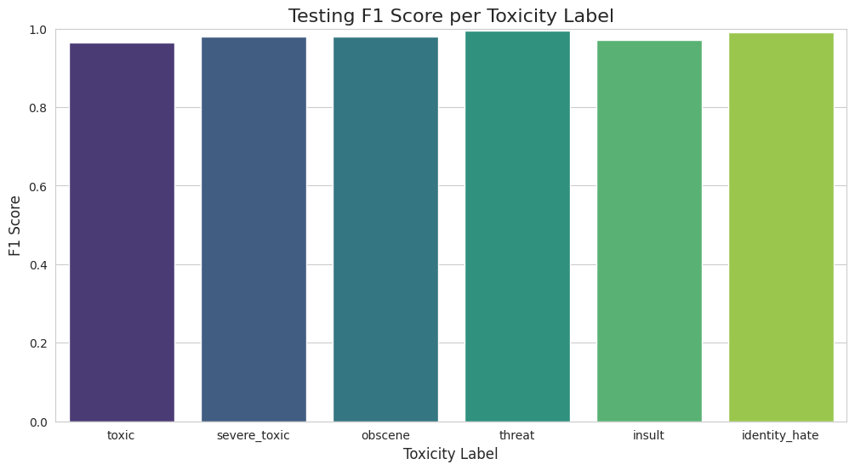
This graph illustrates the Testing F1 Score achieved by the Ensemble Model for each toxicity category. All labels obtained F1 Scores close to 1.0, demonstrating excellent classification performance on unseen test data. The consistently high scores indicate that the model effectively balances Precision and Recall while maintaining strong generalization ability. These results confirm that the model is reliable for detecting multiple types of toxic behaviour in gaming chat messages.
Overall Analysis
All toxicity categories have F1 Scores close to 1.0.
This indicates that the model generalizes well to unseen data.
The small difference between the training and testing F1 Scores suggests that the model is not significantly overfitting and maintains consistent performance.
Key Observations
High Precision and Recall across all toxicity labels.
Consistent performance on unseen test data.
Reliable multi-label toxicity classification.
Strong capability to detect different types of toxic behaviour.
Suitable for real-time gaming chat moderation.

Slide 33
Gradio Application
Gradio-Based User Interface
To make the Gaming Chat Toxicity Classification System interactive and user-friendly, a Gradio web application was developed. The application provides a simple interface where users can enter gaming chat messages and receive instant toxicity predictions along with the detected labels, severity score, and recommended moderation action.
The Gradio interface demonstrates the practical deployment of the trained Ensemble Machine Learning model, enabling real-time toxicity detection without requiring users to interact directly.

Slide 34
Gradio Application Workflow
  User
  │
  ▼
  Enter Chat Message
  │
  ▼
  Click "Submit"
  │
  ▼
  Text Preprocessing
  │
  ▼
  TF-IDF Feature Extraction
  │
  ▼
  Ensemble Machine Learning Model
  │
  ▼
  Multi-Label Classification
  │
  ▼
  Severity Score Calculation
  │
  ▼
  Moderation Recommendation
  │
  ▼
  Display Results in Gradio

Slide 35
Features of the Gradio Application
Simple and intuitive user interface
Real-time toxicity prediction
Supports multi-label classification
Displays detected toxicity labels
Calculates severity score (1–5)
Recommends moderation actions
Clear button to reset inputs
Responsive web-based interface
User Interface Components Component | Description
Textbox | Allows users to enter a gaming chat message.
Submit Button | Sends the message for toxicity analysis.
Output Panel | Displays the prediction results.
Clear Button | Clears the input and output fields.

Slide 36
Conclusion
The Gaming Chat Toxicity Classification System successfully demonstrates the use of Natural Language Processing (NLP) and Machine Learning to automatically detect toxic behaviour in online gaming conversations. By combining TF-IDF feature extraction with an Ensemble Machine Learning model consisting of Logistic Regression and Random Forest using a Soft Voting Classifier, the system effectively performs multi-label toxicity classification across six toxicity categories.
The developed model can identify toxic messages in real time, calculate a severity score, recommend appropriate moderation actions, and generate detection logs for monitoring and analysis. The integration of a Gradio web application further provides an interactive interface, making the system practical for demonstration and deployment.
Overall, the project contributes to creating a safer, healthier, and more positive gaming environment by reducing manual moderation efforts and enabling faster responses to abusive behaviour.
Takeaway
"This project demonstrates how Ensemble Machine Learning and Natural Language Processing can be combined to automate gaming chat moderation, reduce toxic interactions, and create a safer, more enjoyable online gaming experience."

